Slide 1

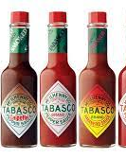
Tabasco Sauce
By: Julia See

Slide 2
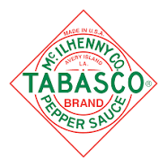
Background
Founded in Avery Island, Louisiana n 1868
Every botte is made in the U.S
Edmund Mcllhenny cultivated tobacco, developed a recipe and began bottling
Quickly grew in the southern U.S during the 19th century
Once Mcllhenny died in 1890, his son took the business and helped the company into a leading condiment manufacturer
Still distributed and owned by the Mcllhenny family
Been around for 153 years

Slide 3

Leading
A family business, but not every family member is involved
Only hires family members they think they can run the business
Strategy: helps manage performance, guide actions, devise different tactics
Participative leadership style
Able to engage/involve its employees in decision making processes and managerial decisions
Style is very effective for achieving goals and vision of organization
Able to identity current and potential conflicts and actively work to resolve them
Ensures all systems are allocated with resources and set targets to achieve business goals

Slide 4

planning
Guide behavior- helps the business guide employees, staff behavior towards the attainment and achievement of goals
Takes into consideration to the activities of their competitors
Considers the customer trends and demands, as well as the evolving consumer market patterns
Ensures that all job tasks and roles are aligned with core values
Ensures a consistent, reliable, brand image, and an honest organizational culture

Slide 5

organiznig
Mcllhenny took over the product in 1870, by the end of the decade the sauce was being sold as far as England
Being flexible and adaptable- able to quickly react and respond to change consumer patterns globally, also able to locally and culturally adapt its product for different countries and regions
Structure- organizational hierarchy allows quicker decision-making processes
Communication enhances the overall organization structure- allows easy flow of information
Well-demarked system to ensure business operations are managed effectively

Slide 6

controlling
High coordination between different departments- effective and organized
Encourages teamwork and team-oriented tasks
Makes sure that supervisors oversee, approve of efforts and tactics employees choose
Each of the demarcated systems has tools and methods as controls for evaluating performance and attaining goals
Continually evaluates its systems through observations and informal discussions
Feed back is given regularly and is required, as formal evaluation is semi-annually

Slide 7
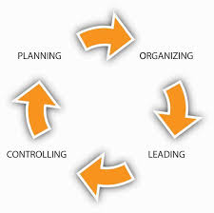


Question
The Tabasco company uses a little of each intertwining with one another, which one of the 4 components of the management styles do you think Tabasco executes the best? Why?
Which one of the 4 do you think is most effective given how global, and big this company is? Why?

